Slide 1
The list of regularizing modules

Slide 2

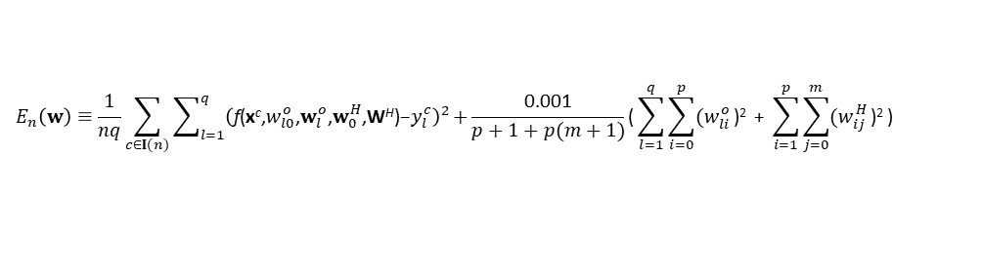


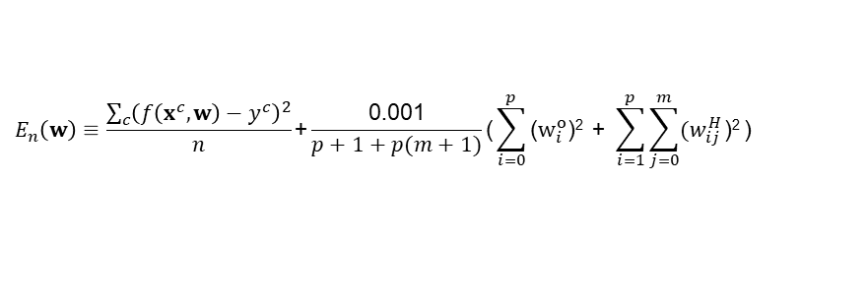



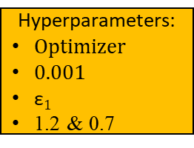
$$E_{n}\left(w\right)≡\frac{\sum_{c}{{\left(f\left(x^{c},w\right)−y^{c}\right)}^{2}}}{n}\text{+}\frac{\text{0.001}}{p+1+p(m+1)}\text{(}\sum_{i=0}^{p}{\text{(}w_{i}^{o}\text{)}\text{2}}\text{ + }\sum_{i=1}^{p}{\sum_{j=0}^{m}{{(w}_{ij}^{H}}\text{)}\text{2}}\text{)}$$
The regularizing module
helps further regularize weights after obtaining an acceptable SLFN.
$$E_{n}\left(w\right)≡\frac{1}{nq}\sum_{c∈I(n)}{\sum_{l=1}^{q}{{\left(\text{f}\text{(}\text{x}\text{c}\text{,}w_{l0}^{o}\text{,}w_{l}^{o}\text{,}w_{0}^{H}\text{,}\text{W}\text{H}\text{)}\text{−}y_{l}^{c}\right)}^{2}}}\text{+}\frac{\text{0.001}}{p+1+p(m+1)}\text{(}\sum_{l=1}^{q}{\sum_{i=0}^{p}{{(w}_{li}^{o}}\text{)}\text{2}}\text{ + }\sum_{i=1}^{p}{\sum_{j=0}^{m}{{(w}_{ij}^{H}}\text{)}\text{2}}\text{)}$$
An acceptable SLFN that accomplishes the learning goal
The acceptability is determined by the learning goal
$$η$$
Implement the optimizer and calculate $w′$
Store w
forward operation
$w^{′}→w$ $$1.2 η→η$$
Hyperparameters:
Optimizer
0.001
$\text{ε}1$
1.2 & 0.7
true
$$E_{n}\left(w′\right)≤E_{n}\left(w\right)$$
true
Learning goal
false
false
Restore $w$
$$\& 0.7η→η$$
true
$$η>\text{ε}1$$
false
An acceptable SLFN that has a preference on weights
Restore w

Slide 3

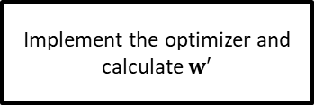
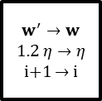
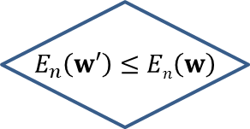
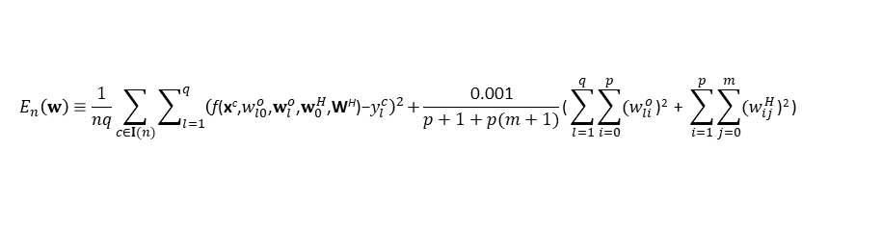

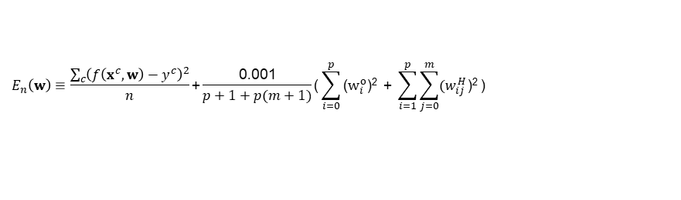
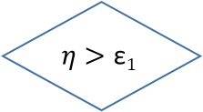
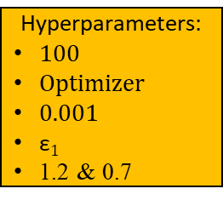
$$E_{n}\left(w\right)≡\frac{\sum_{c}{{\left(f\left(x^{c},w\right)−y^{c}\right)}^{2}}}{n}\text{+}\frac{\text{0.001}}{p+1+p(m+1)}\text{(}\sum_{i=0}^{p}{\text{(}w_{i}^{o}\text{)}\text{2}}\text{ + }\sum_{i=1}^{p}{\sum_{j=0}^{m}{{(w}_{ij}^{H}}\text{)}\text{2}}\text{)}$$
The regularizing module
$$E_{n}\left(w\right)≡\frac{1}{nq}\sum_{c∈I(n)}{\sum_{l=1}^{q}{{\left(\text{f}\text{(}\text{x}\text{c}\text{,}w_{l0}^{o}\text{,}w_{l}^{o}\text{,}w_{0}^{H}\text{,}\text{W}\text{H}\text{)}\text{−}y_{l}^{c}\right)}^{2}}}\text{+}\frac{\text{0.001}}{p+1+p(m+1)}\text{(}\sum_{l=1}^{q}{\sum_{i=0}^{p}{{(w}_{li}^{o}}\text{)}\text{2}}\text{ + }\sum_{i=1}^{p}{\sum_{j=0}^{m}{{(w}_{ij}^{H}}\text{)}\text{2}}\text{)}$$
The acceptability is determined by the learning goal
An acceptable SLFN that accomplishes the learning goal
$$η$$
i = 1
An acceptable SLFN that has a preference on weights
true
i >= 100
false
Store w
Hyperparameters:
100
Optimizer
0.001
$\text{ε}1$
1.2 & 0.7
Implement the optimizer and calculate $w′$
$w^{′}→w$ $$1.2 η→η$$
i+1 $→$ i
Forward operation
Restore w
& $0.7η→η$
$$E_{n}\left(w′\right)≤En\left(w\right)$$
Learning goal
true
true
false
false
true
$$η>\text{ε}1$$
false
An acceptable SLFN that has a preference on weights
Restore w

